Slide 1
Leave Management System
Submission type : Individual
Name: Vedika Deshmukh
Batch : HDFC API
Program :API Developer
Date: 20/04/2023

Slide 2
TABLE OF CONTENTS
01
04
About the Project
Timeline
02
05
Requirements
Modules
03
06
Architecture
Project Overview
Here you could describe
the topic of the section
Here you could describe
the topic of the section
Here you could describe
the topic of the section
Here you could describe
the topic of the section
Here you could describe
the topic of the section
Here you could describe
the topic of the section

Slide 3
ABOUT THE PROJECT
The Office Leave Management Application is a software application that automates the office leave management procedure. The goal of this system is to streamline the leave application process, reduce administrative expense, and increase overall employee satisfaction.

Slide 4
REQUIREMENTS
Hardware
Software
OS: Windows
RAM: 8 gb
IDE: Eclipse
Language: JAVA jdk11/8
Database: MYSql
Testing:Postman/swagger

Slide 5
Architecture
Use Case Diagram
Sequence Diagram
Class Diagram

Slide 6
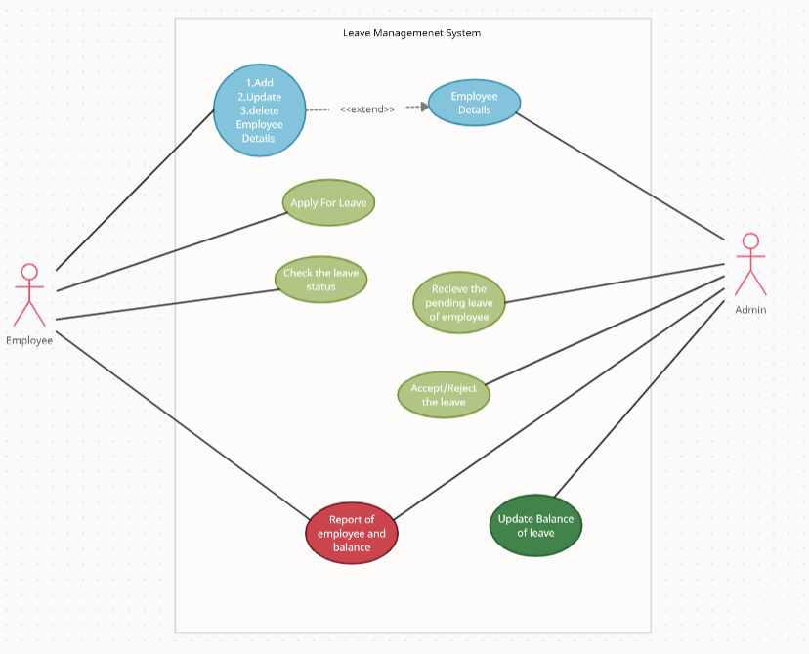
Use Case Diagram

Slide 7
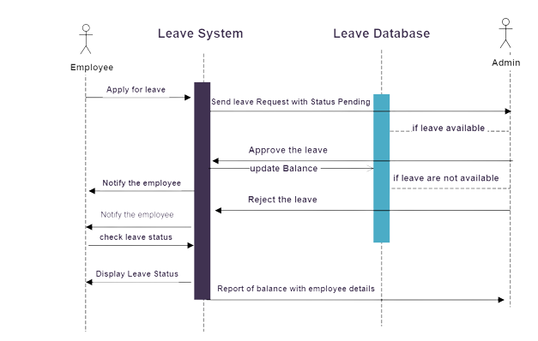
Sequence Diagram

Slide 8
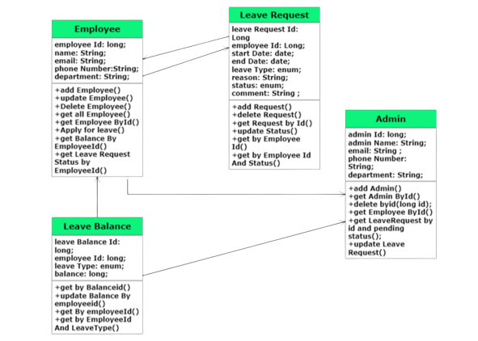
Class Diagram

Slide 9
OUR TIMELINE
Day 3
Day 1
Requirement
FINAL
VERSION
Day 2
Started working on Backend
Architecture
Progress and Testing Functionality
Created database

Slide 10
Module
ADMIN
Employee
Leave
Admin has all the access to Employee details , leave Request Leave Balance
Employee can add employee details and also can send leave request to admin
Here all the operation on leave balance and leave request is performed

Slide 11



Project OverView
DATABASE
ADMIN
EMPLOYEE

Slide 12
Database
Employee id
long
Leave request id
long
employee id
long
Department
VARCHAR()
Leave type
VARCHAR()
Employee Table
Name
VARCHAR()
start date
VARCHAR()
Leave Request Table
end date
VARCHAR()
EMail
VARCHAR()
reason
VARCHAR()
Phone No.
VARCHAR()
status
VARCHAR()
comment
VARCHAR()
Admin id
long
leave balance id
long
Department
VARCHAR()
Admin Table
employee id
long
Leave Balance Table
Admin Name
VARCHAR()
balance
long
EMail
VARCHAR()
Leave type
VARCHAR()
Phone No.
VARCHAR()

Slide 13
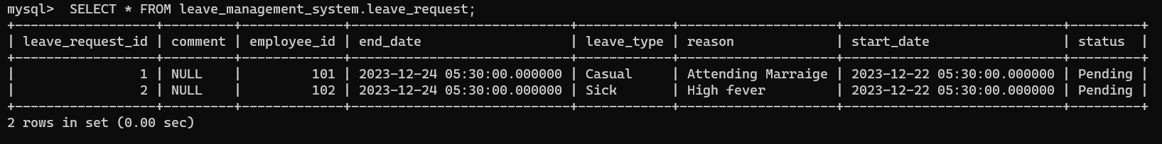
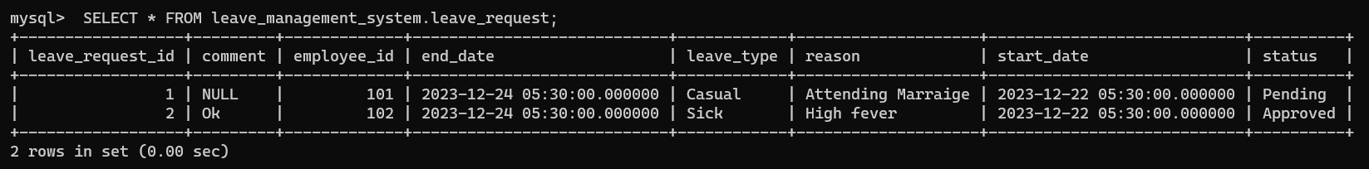
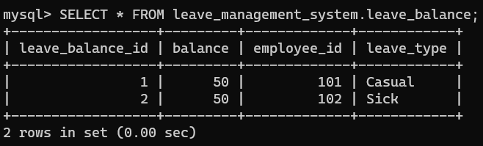

Slide 14
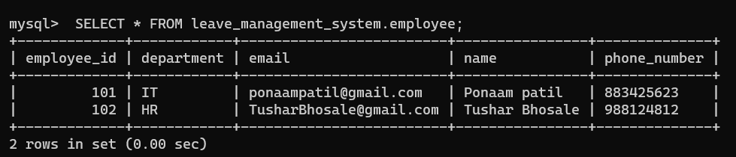
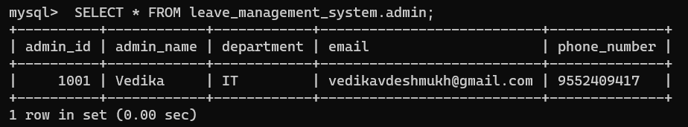

Slide 15
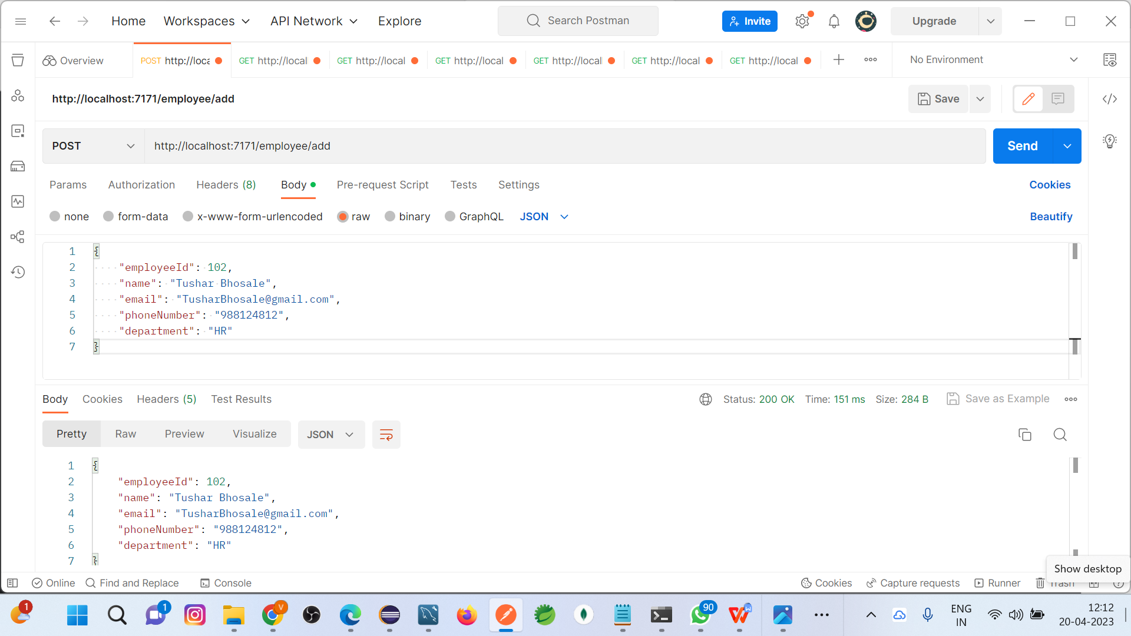
Employee

Slide 16
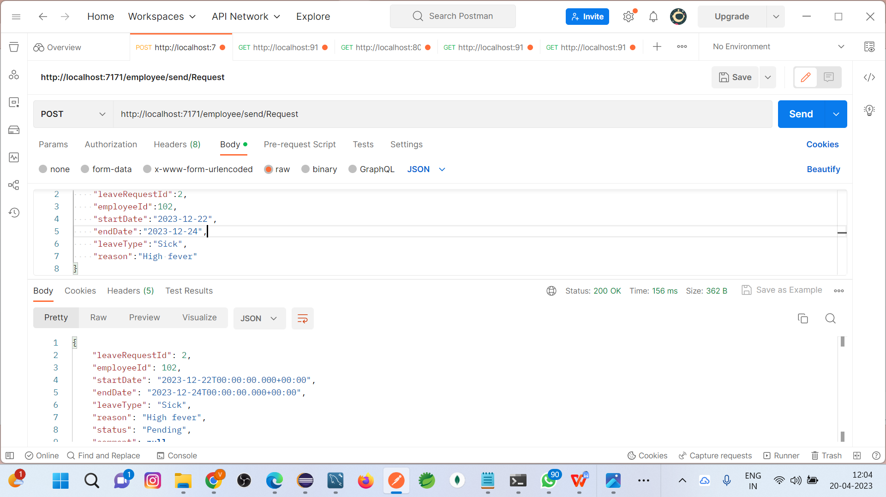

Slide 17
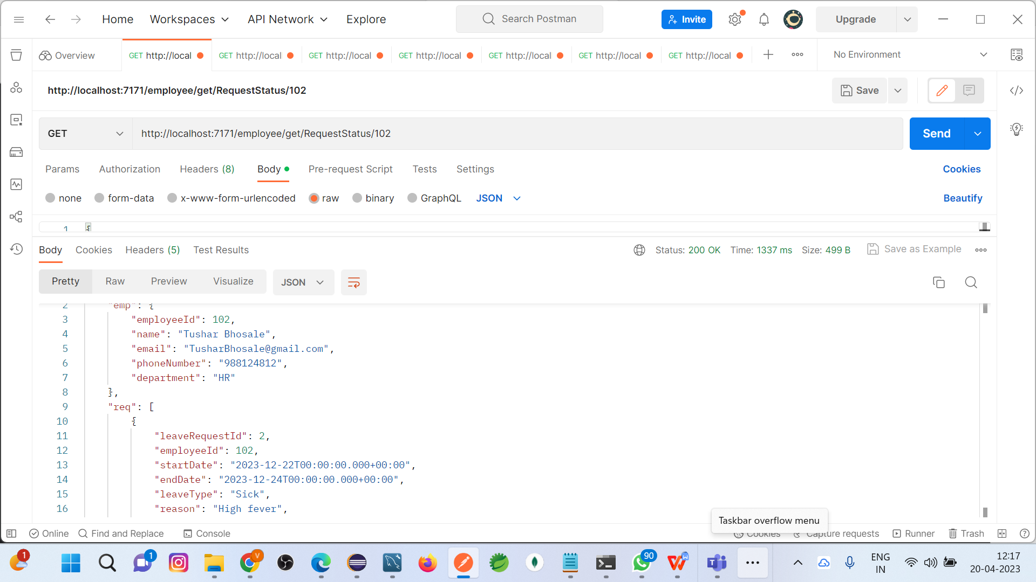

Slide 18
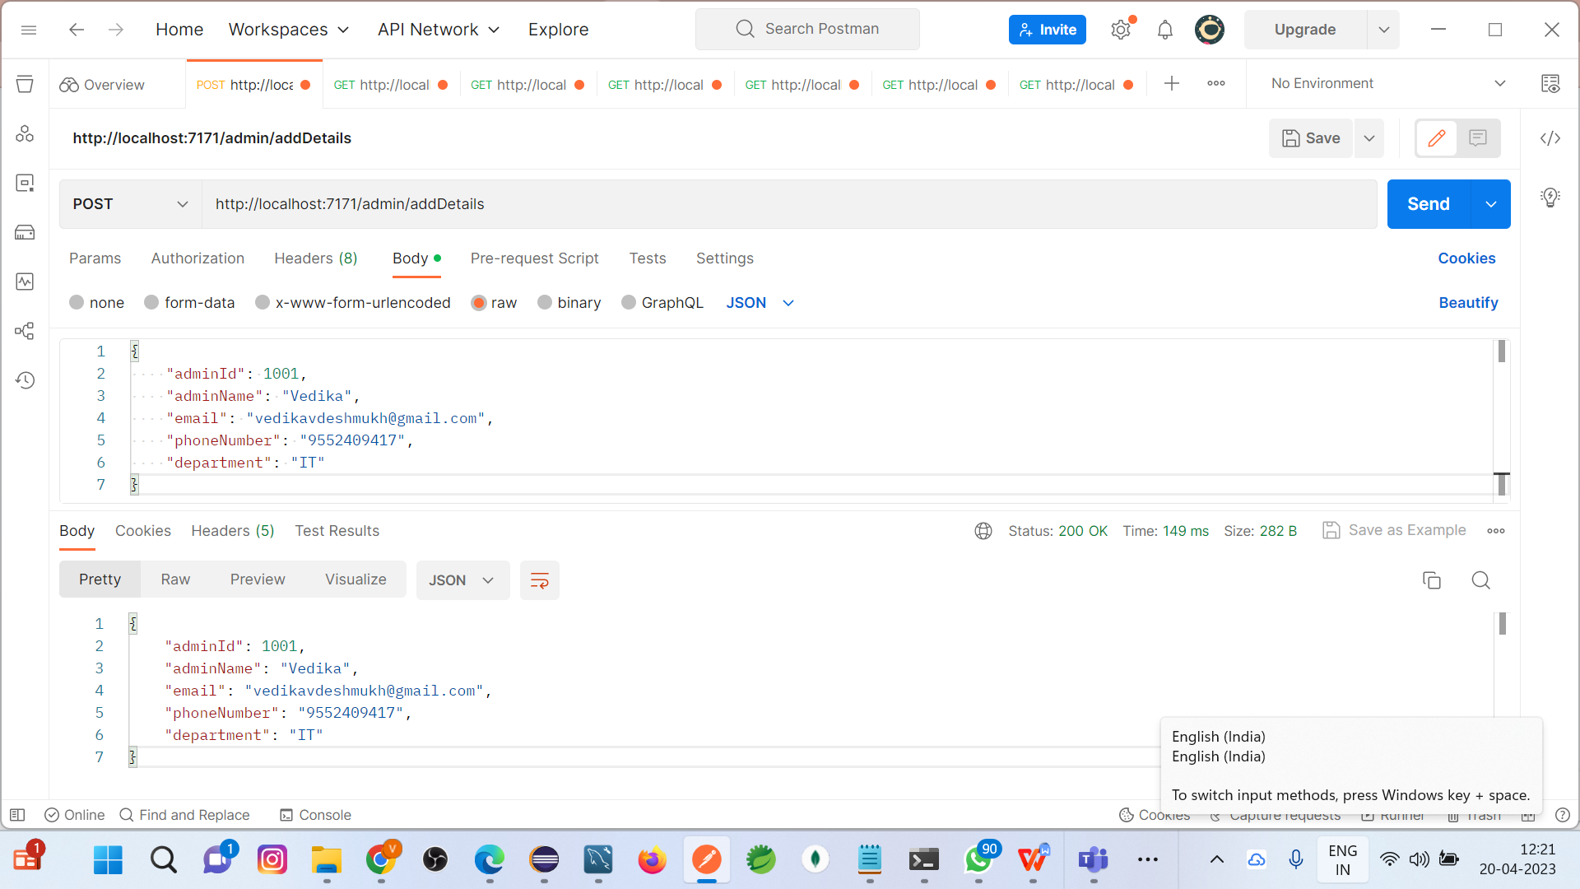
Admin

Slide 19
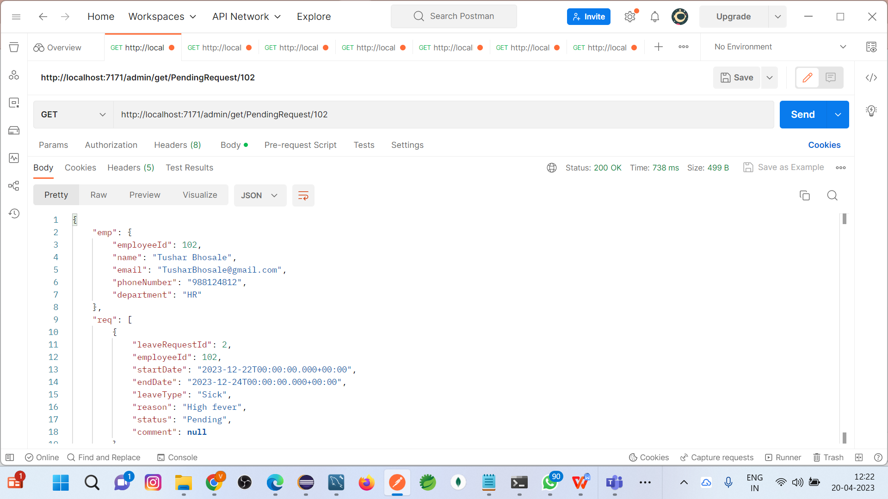

Slide 20
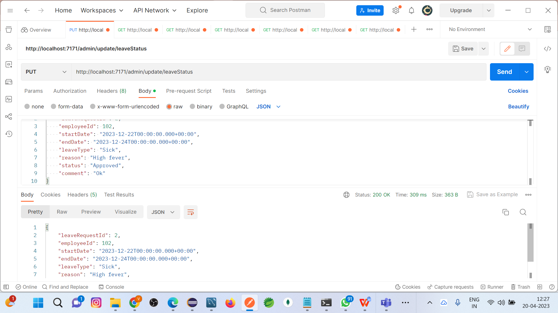

Slide 21
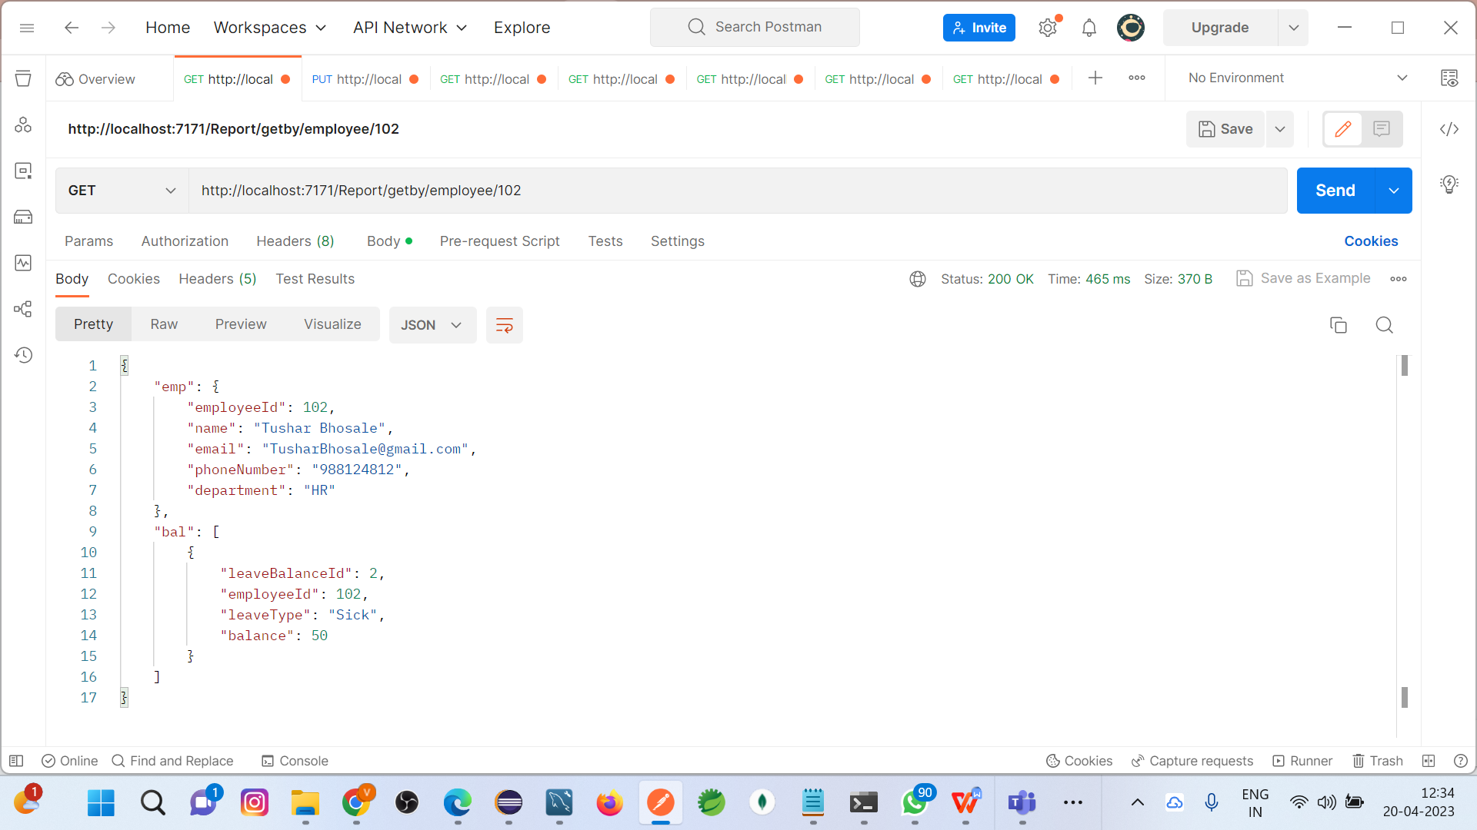
Report

Slide 22
THANKS!
Question?

